Slide 1


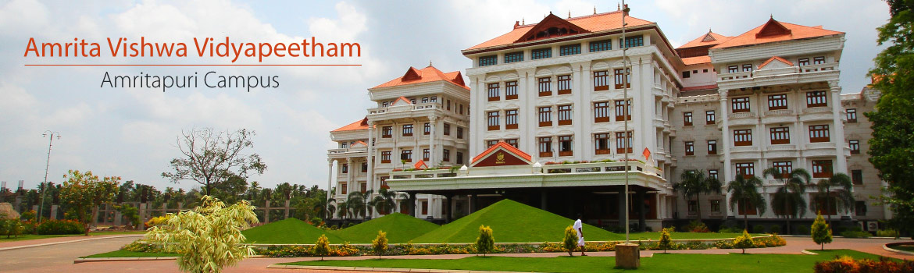

Deep Learning Frameworks

Slide 2
Deep Learning Frameworks

Slide 3
2025
Top Deep Learning Frameworks
1. TensorFlow
2. PyTorch
3. Keras
4. Sonnet
5. MXNet
6. Swift for TensorFlow
7. Gluon
8. DL4J
9. ONNX
10. Chainer

Slide 4
Popular Frameworks
Google’s open-source platform TensorFlow
TensorFlow is JavaScript-based and comes equipped with a wide range of tools and community resources that facilitate easy training and deploying ML/DL models
TensorFlow Lite to deploy models on mobile or embedded devices.
Keras
Keras was developed and maintained by François Chollet, a Google engineer
Another open-source Deep Learning framework on our list is Keras. This nifty tool can run on top of TensorFlow, Theano, Microsoft Cognitive Toolkit, and PlaidML.
Keras performs brilliantly for high-level computations, low-level computation isn’t its strong suit.
excellent for beginners who have just started their journey in this field. It allows for easy learning and prototyping simple concepts
PyTorch is an open-source Deep Learning framework developed by Facebook
C++ frontend atop a Python interface.
based on the Torch library-to expedite the entire process from research prototyping to production deployment.
It is excellent for training, building, deploying small projects and prototypes.
It is extensively used for Deep Learning applications like natural language processing and computer vision.

Slide 5
Torch : PyTorch
Torch is an open-source machine learning library, a scientific computing framework, and a script language based on the Lua programming language. It provides a wide range of algorithms for deep learning, and uses the scripting language LuaJIT, and an underlying C implementation. As of 2018, Torch is no longer in active development. However PyTorch, which is based on the Torch library, is actively developed as of June 2021
PyTorch is an open-source machine learning library based on the Torch library, used for applications such as computer vision and natural language processing, primarily developed by Facebook's AI Research lab (FAIR).
PyTorch is gaining popularity for its simplicity, ease of use, dynamic computational graph and efficient memory usage

Slide 6
TOP PYTORCH PROJECTS
CheXNet: Radiologist-level pneumonia detection on chest X-rays with deep learning. (https://stanfordmlgroup.github.io/projects/chexnet/)
PYRO: Pyro is a universal probabilistic programming language (PPL) written in Python and supported by PyTorch on the backend. (https://pyro.ai/)
Horizon: A platform for applied reinforcement learning (Applied RL) (https://horizonrl.com)
These are a few frameworks and projects that are built on top of TensorFlow and PyTorch. You can find more on Github and the official websites of TF and PyTorch.

Slide 7
TOP TENSORFLOW PROJECTS
Magenta: An open-source research project exploring the role of machine learning as a tool in the creative process. (https://magenta.tensorflow.org/)
Sonnet: Sonnet is a library built on top of TensorFlow for building complex neural networks. (https://sonnet.dev/)
Ludwig: Ludwig is a toolbox to train and test deep learning models without the need to write code. (https://uber.github.io/ludwig/)

Slide 8
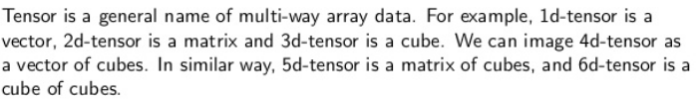
Tensors
What are Tensors?
A tensor is a generalization of vectors and matrices and is easily understood as a multidimensional array.
In the general case, an array of numbers arranged on a regular grid with a variable number of axes is known as a tensor.
Tensors
Tensors are a specialized data structure that are very similar to arrays and matrices. In PyTorch, we use tensors to encode the inputs and outputs of a model, as well as the model’s parameters. Tensors are similar to NumPy’s ndarrays, except that tensors can run on GPUs or other specialized hardware to accelerate computing.

Slide 9
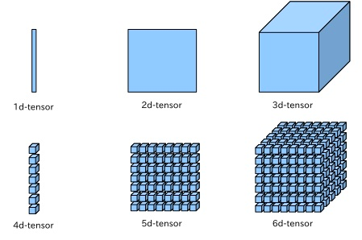
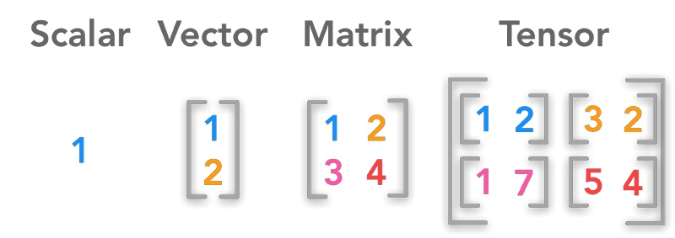
Tensors

